Slide 1
Sales Analytics by Mushir

Slide 2
Sales Analytics
INTRODUCTION:
Over the past 12 months, dataset detailing sales transactions. This dataset includes various attributes such as product names, quantities ordered, prices, dates of purchase, and customer information. Analyzing this data provides valuable insights into our sales performance

Slide 3
Data Overview :
 | Order ID | Product | Quantity Ordered | Price Each | Order Date | Purchase Address | Month | Sales | City | Hour | Minute
0 | 176558 | USB-C Charging Cable | 2 | 11.95 | 2019-04-19 08:46:00 | 917 1st St, Dallas, TX 75001 | 4 | 23.90 | Dallas (TX) | 8 | 46
2 | 176559 | Bose SoundSport Headphones | 1 | 99.99 | 2019-04-07 22:30:00 | 682 Chestnut St, Boston, MA 02215 | 4 | 99.99 | Boston (MA) | 22 | 30
3 | 176560 | Google Phone | 1 | 600.00 | 2019-04-12 14:38:00 | 669 Spruce St, Los Angeles, CA 90001 | 4 | 600.00 | Los Angeles (CA) | 14 | 38
4 | 176560 | Wired Headphones | 1 | 11.99 | 2019-04-12 14:38:00 | 669 Spruce St, Los Angeles, CA 90001 | 4 | 11.99 | Los Angeles (CA) | 14 | 38
5 | 176561 | Wired Headphones | 1 | 11.99 | 2019-04-30 09:27:00 | 333 8th St, Los Angeles, CA 90001 | 4 | 11.99 | Los Angeles (CA) | 9 | 27

Slide 4
Sales Analytics Questions:
Question 1: What was the best month for sale ? How much earned that month?
Question 2: What City had the highest number of sales ?
Question 3: What time should we display advertisements to maximize likelihood of customer's buying product ?
Question 4: What products are most often sold together?
Question 5: What product sold most ? why do you think it sold most?

Slide 5
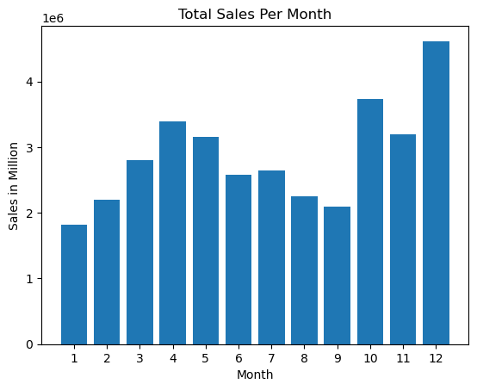
Question 1: What was the best month for sale ? How much earned that month?
Ans - We can see in graph, the December Month have heights Sale.

Slide 6
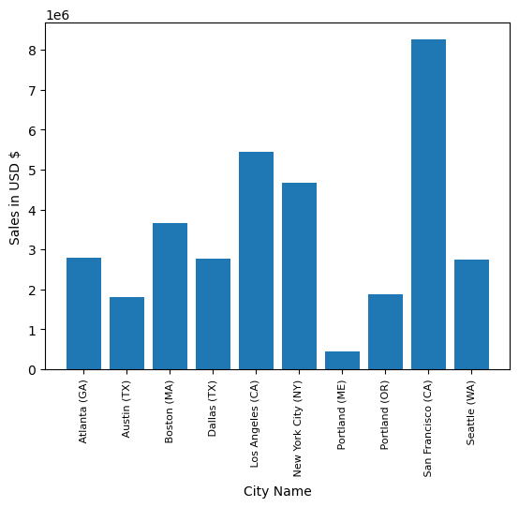
Question-2 What City had the highest number of sales ?
Ans - San Francisco City has highest Sales.

Slide 7
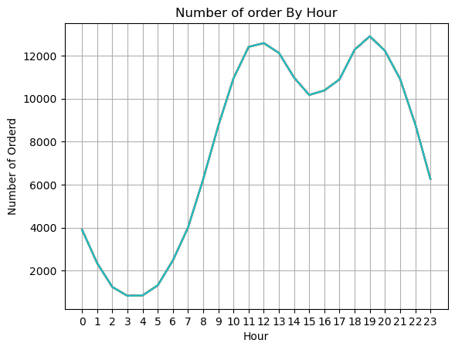
Question-3 What time should we display advertisements to maximize likelihood of customer's buying product ?
Ans - 11 am & 7 pm (19) is best time for advertisements.

Slide 8
Question - 4 What products are most often sold together?
iPhone and Lightning Charging Cable - 1005 times
Google Phone and USB-C Charging Cable - 987 times
iPhone and Wired Headphones - 447 times
Google Phone and Wired Headphones - 414 times
Vareebadd Phone and USB-C Charging Cable - 361 times
iPhone and Apple Air pods Headphones - 360 times
Google Phone and Bose SoundSport Headphones - 220 times
USB-C Charging Cable and Wired Headphones - 160 times
Vareebadd Phone and Wired Headphones - 143 times
Lightning Charging Cable and Wired Headphones - 92 times

Slide 9
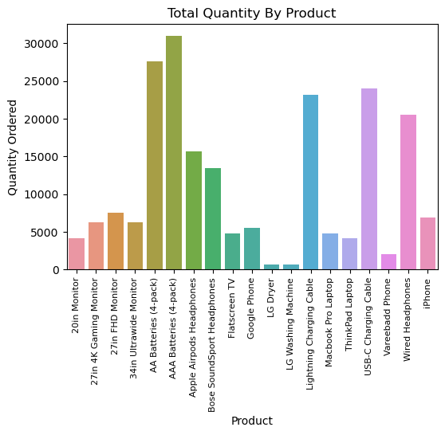
Question - 5 What product sold most ? why do you think it sold most?

Slide 10
Thank you !
By Mushir

